Slide 1
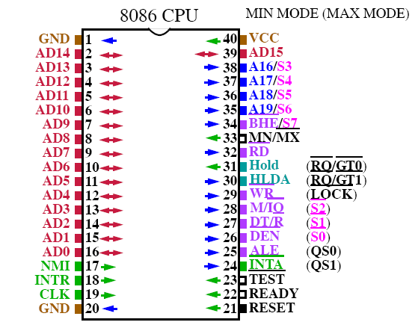
PIN DIAGRAM OF 8086

Slide 2
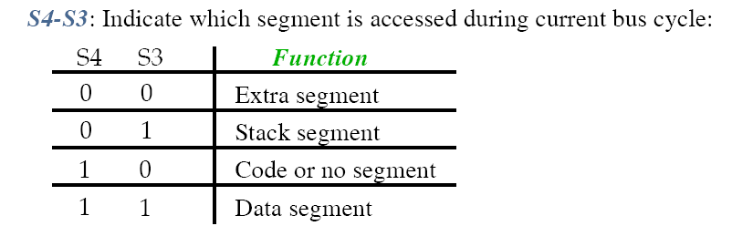
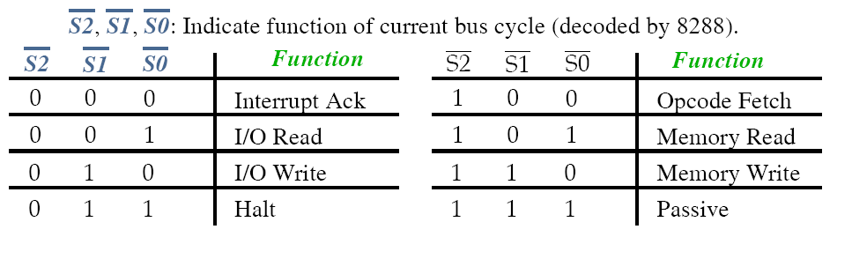

Slide 3
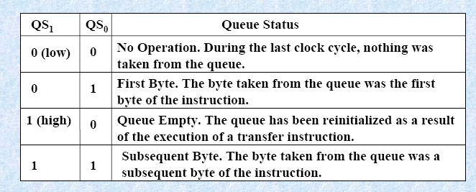
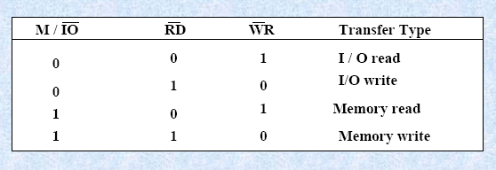

Slide 4
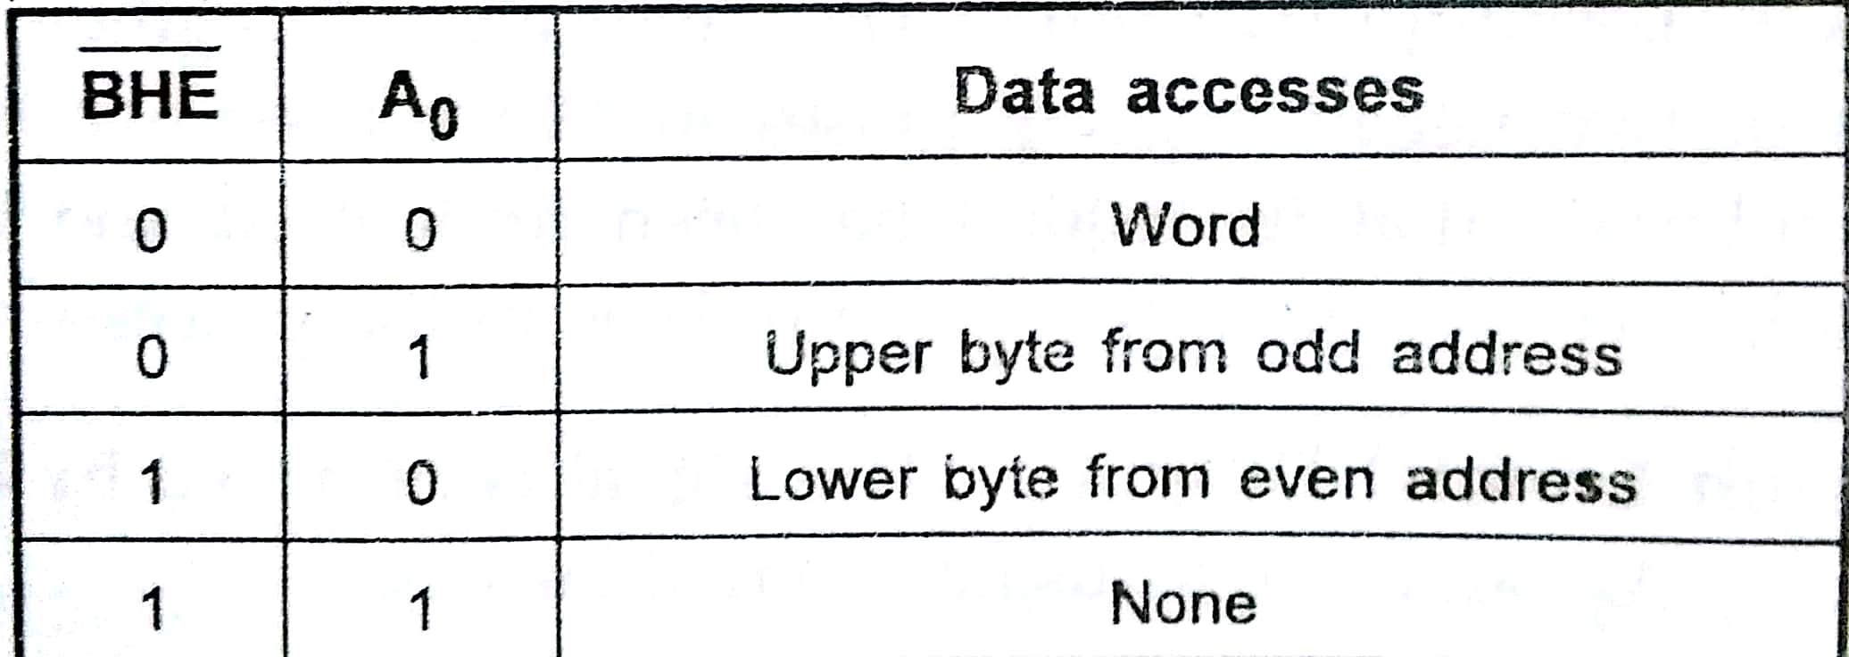

Slide 5
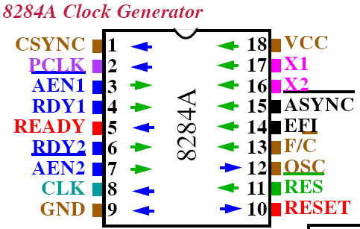
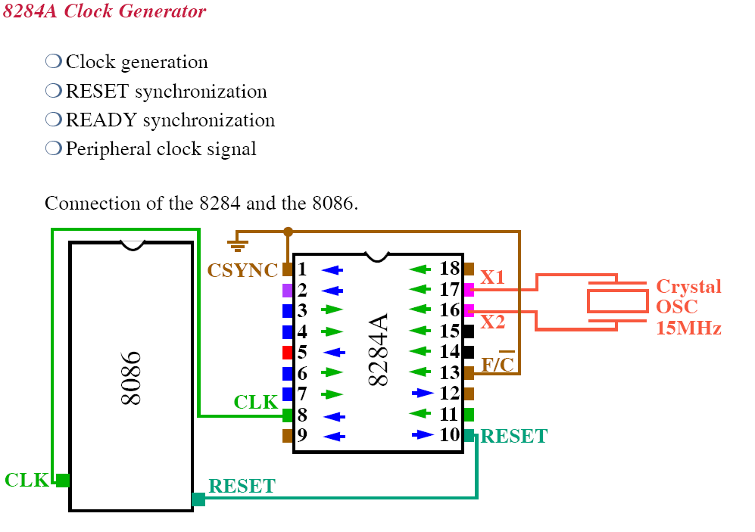
22

Slide 6
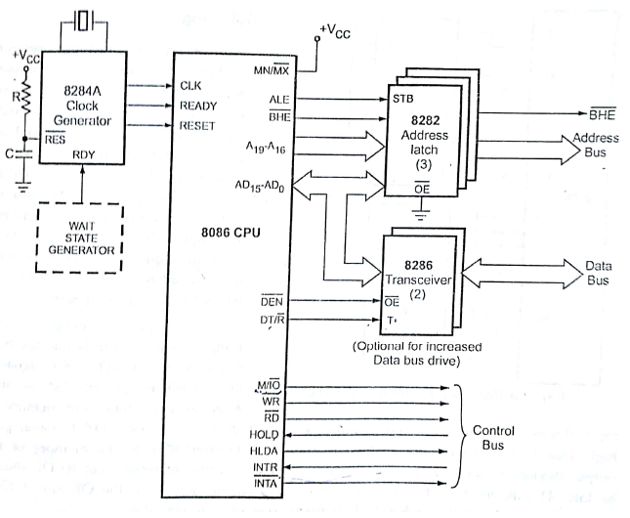
Minimum mode operation of 8086

Slide 7
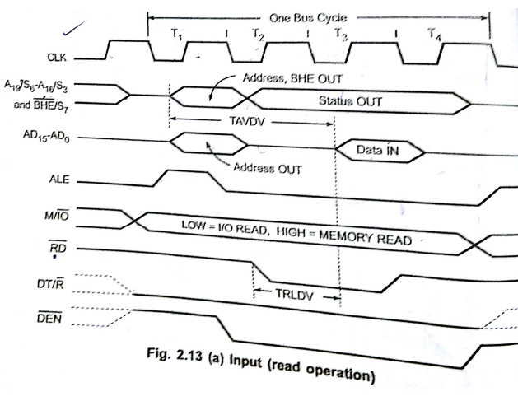

Slide 8
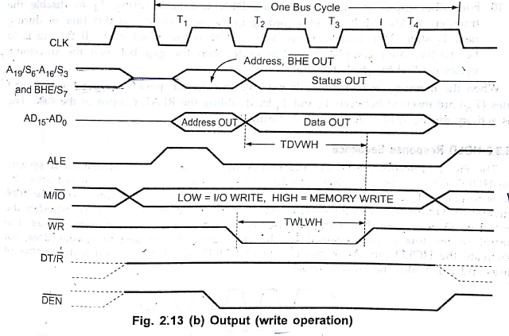

Slide 9
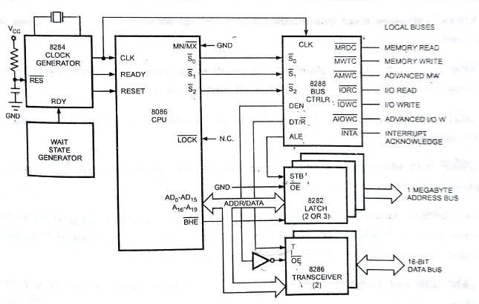
Maximum mode operation of 8086

Slide 10
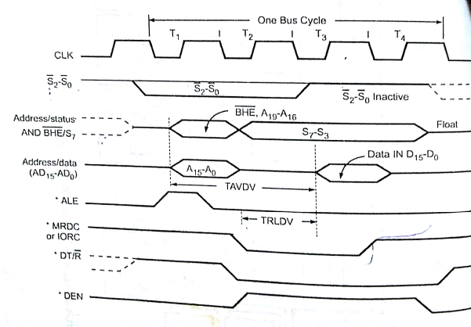
Read Operation

Slide 11
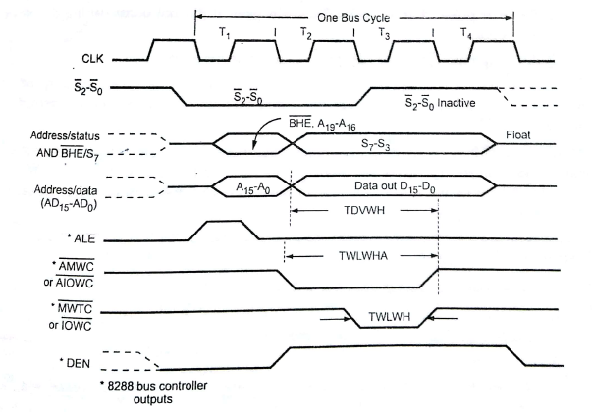
Write Operation

Slide 12
Memory Interfacing
• We have four common types of memories:
• Read only memory ( ROM )
• Flash memory ( EEPROM )
• Static Random access memory ( SARAM )
• Dynamic Random access memory ( DRAM ).
• Pin connections common to all memory devices are: The address input, data
input/outputs, selection input and control input used to select a read or
write operation.
• Address connections: All memory devices have address inputs that select a
memory location within the memory device. Address inputs are labeled from A0
to An.
• Data connections: All memory devices have a set of data inputs/outputs.
• Selection connections: Each memory device has an input, that selects or enables
the memory device. This kind of input is most often called a chip select ( CS ),
chip enable ( CE ) or simply select ( S ) input.

Slide 13
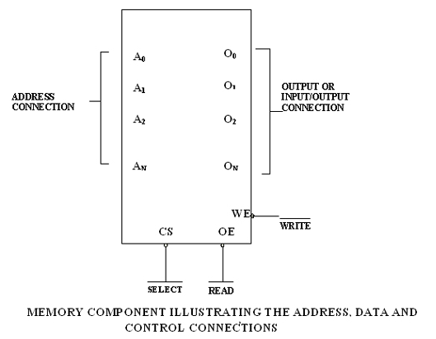
11 Address lines 2¹*2¹⁰=2KBytes=2024Bytes

Slide 14
• RAM memory generally has at least one CS or S input and ROM at least one
CE .
• If the CE , CS, S input is active the memory device perform the read or write.
• If it is inactive the memory device cannot perform read or write operation.
• If more than one CS connection is present, all most be active to perform read or
write data.
• Control connections: A ROM usually has only one control input, while a RAM
often has one or two control inputs.
• The control input most often found on the ROM is the output enable ( OE ) or
gate ( G ), this allows data to flow out of the output data pins of the ROM.
• If OE and the selected input are both active, then the output is enable, if OE is
inactive, the output is disabled at its high-impedance state.
• The OE connection enables and disables a set of three-state buffer located within
the memory device and must be active to read data.
• A RAM memory device has either one or two control inputs. If there is one
control input it is often called R/W.
• This pin selects a read operation or a write operation only if the device is selected
by the selection input ( CS ).

Slide 15
• The ROM read only memory permanently stores programs and data and data was always present, even when power is disconnected.
• It is also called as nonvolatile memory.
• EPROM ( erasable programmable read only memory ) is also erasable if exposed to high intensity ultraviolet light for about 20 minutes or less, depending upon the
type of EPROM.
• We have PROM (programmable read only memory )
• The flash memory is also called as an EEPROM (electrically erasable programmable ROM), EAROM (electrically alterable ROM ), or a NOVROM ( nonvolatile ROM ).
• These memory devices are electrically erasable in the system, but require more time to erase than a normal RAM.
The RAM random access memory is a read/write memory, data loss when power is disconnected.
• It is also called as volatile memory.
• EPROM contains the series of 27XXX contains the following part numbers :
2704( 512 * 8 ), 2708(1K * 8 ), 2716( 2K * 8 ), 2732( 4K * 8 ), 2764( 8K * 8 ),
27128( 16K * 8) etc..
• Each of these parts contains address pins, eight data connections, one or more chip selection inputs (CE ) and an output enable pin (OE ).

Slide 16
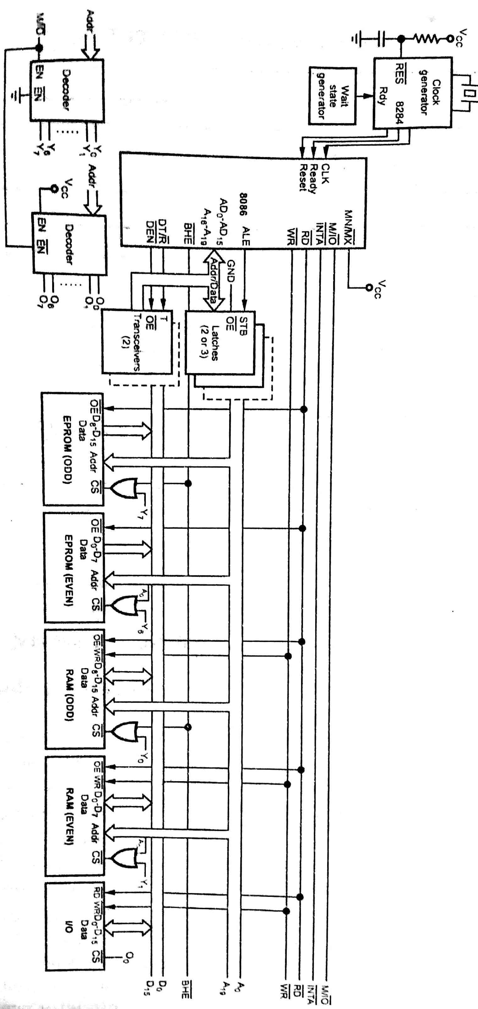

Slide 17
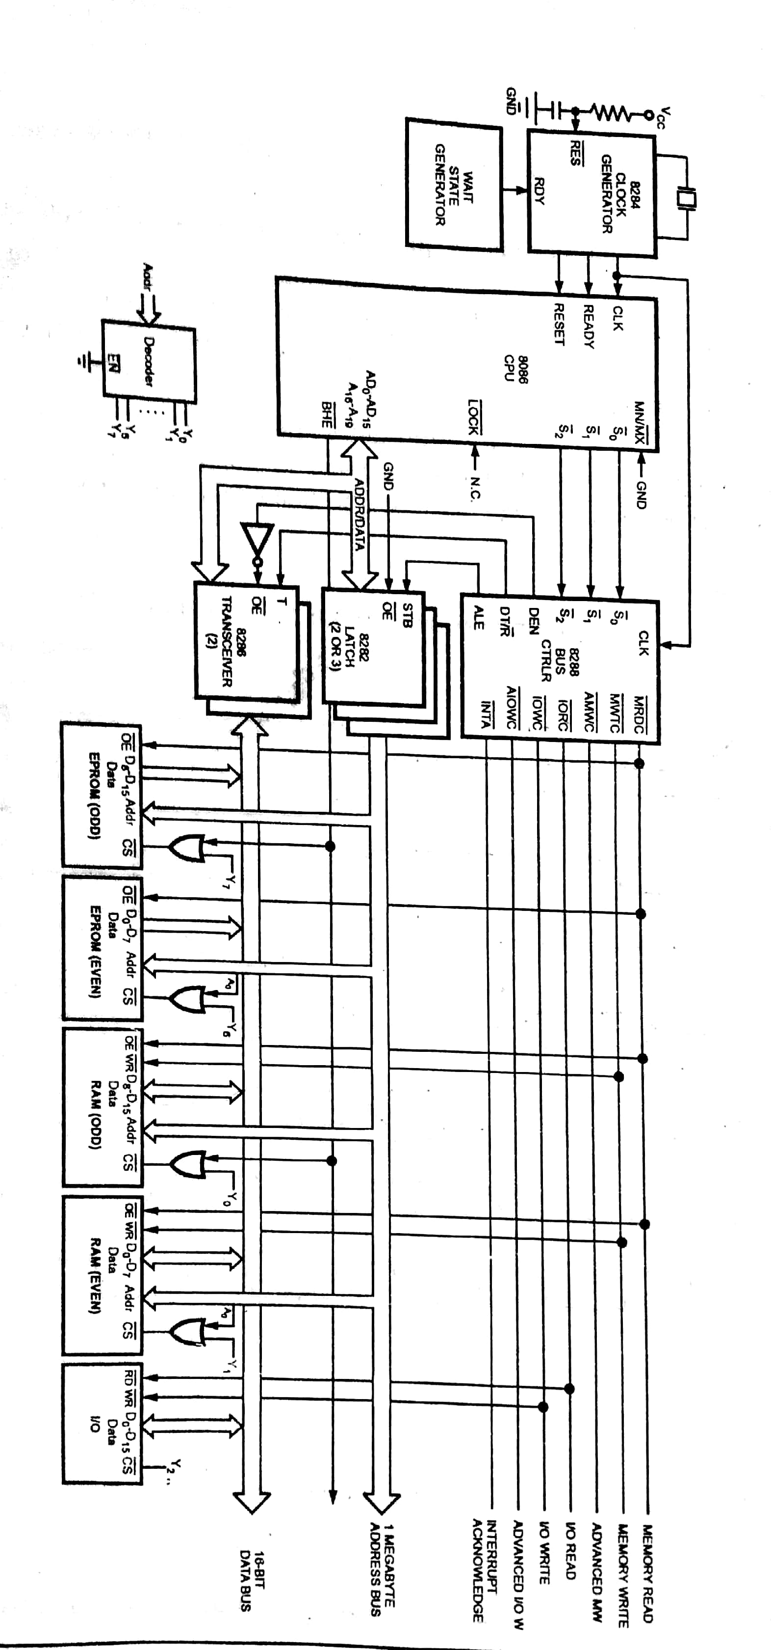

Slide 18
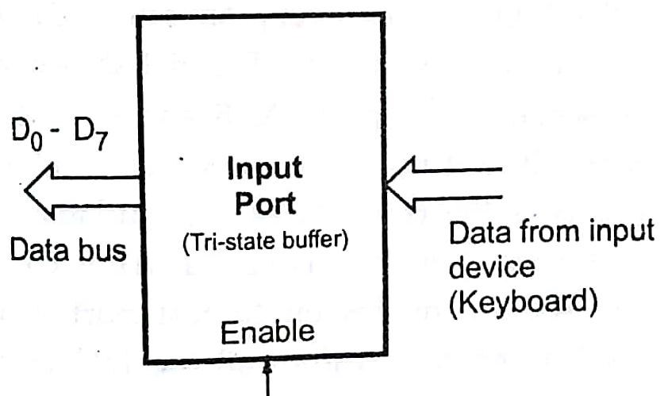
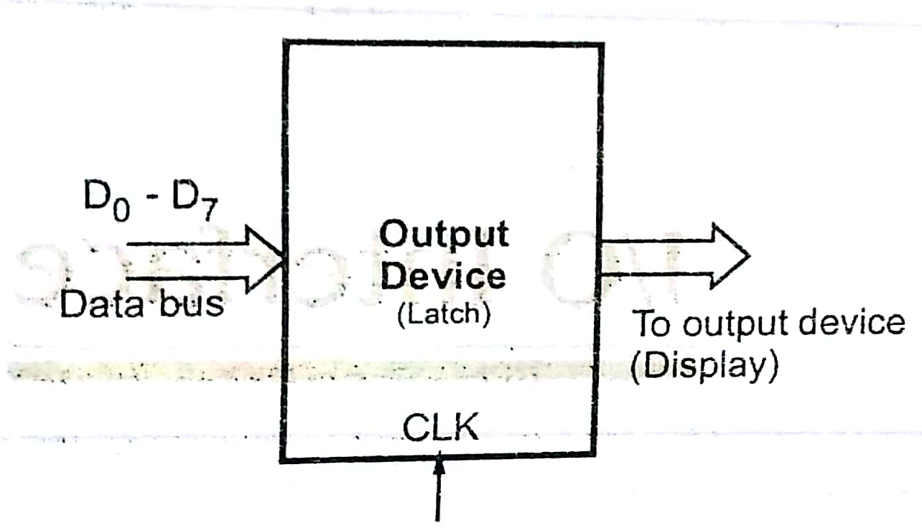
I/O Interface

Slide 19
The input/output devices can be interfaced with microprocessor in two ways:
(i) I/O Mapped I/O
(ii) Memory mapped I/O
I/O Mapped I/O:
The 8086 has four special instructions IN, INS, OUT, and OUTS to transfer data through the input/output ports in this mode.
The IN instruction copy the data from a port to the accumulator
If an 8-bit port is read AL is used, if a word is read AX is used.
OUT instruction copies data from Accumulator to port.
The M/IO⁻ signal is always low for this mode.
Only 256 (2⁸) I/O addresses can be generated for direct addressing mode and 65536 (2¹⁶) I/O addresses can be generated for indirect addressing mode.

Slide 20
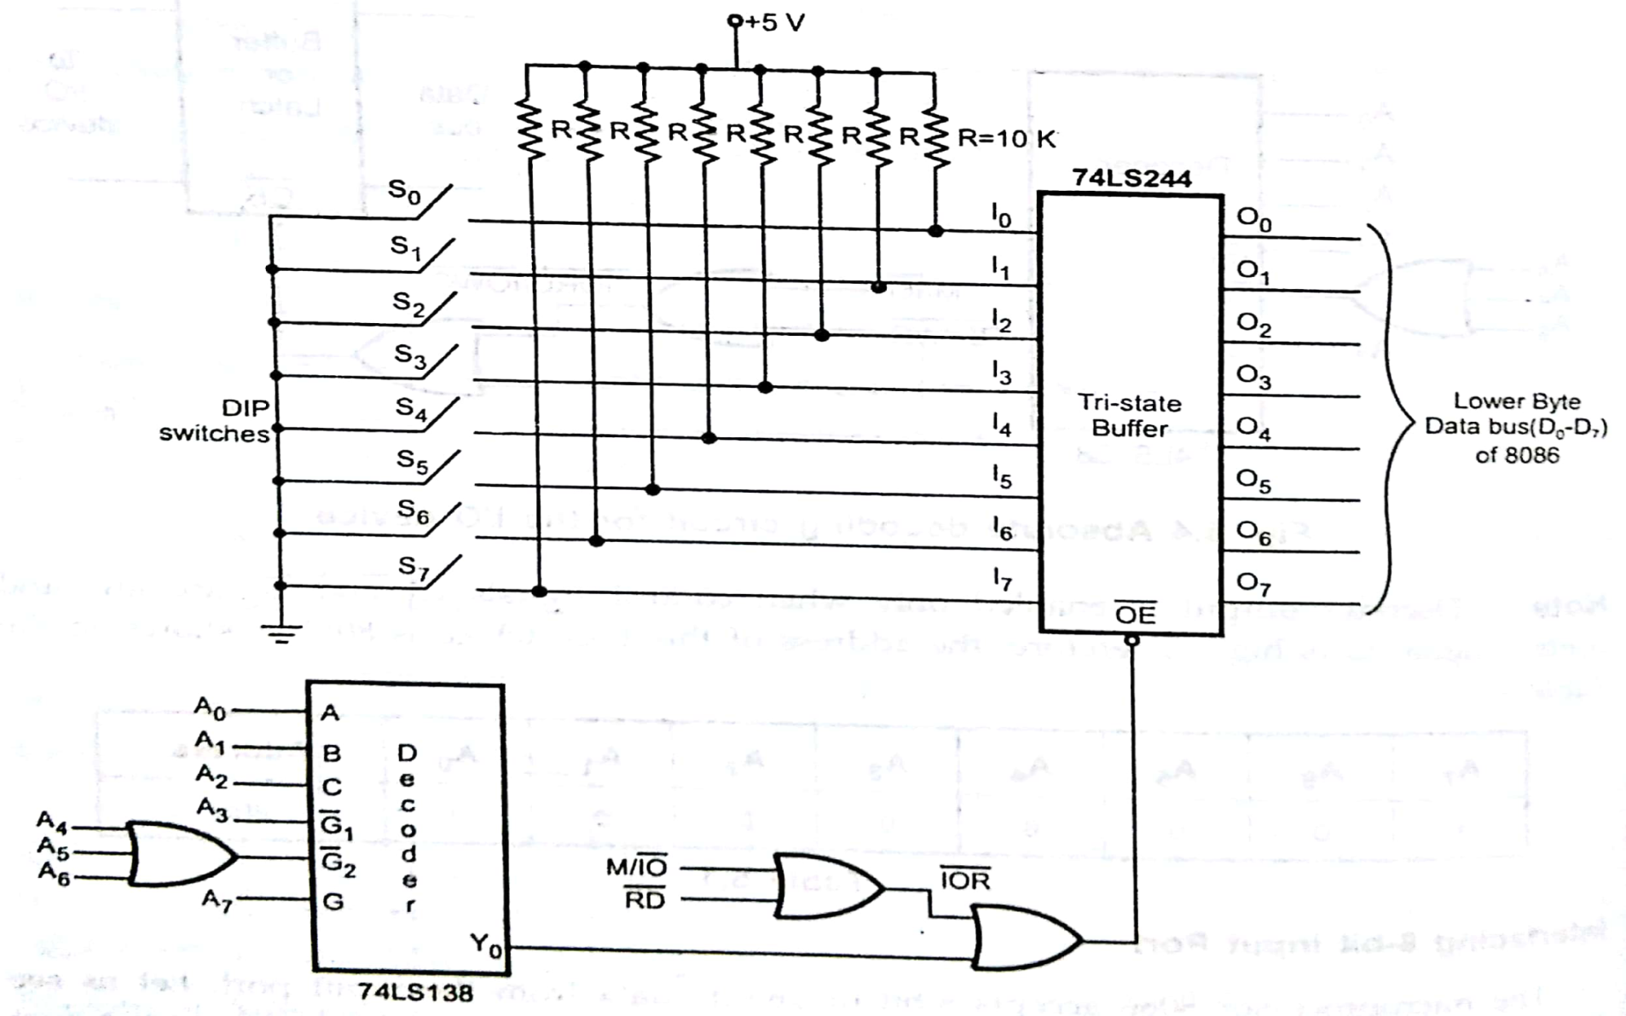
(ii) Memory mapped I/O :
The M/IO⁻ signal is always high for this mode.
The 8086 uses 20 address lines to identify an I/O device.
‘I’ switch closed
‘0’ switch opened
MOV AL,0FFH
IN 80H,AL
INT 3
Interfacing 8-bit input port

Slide 21
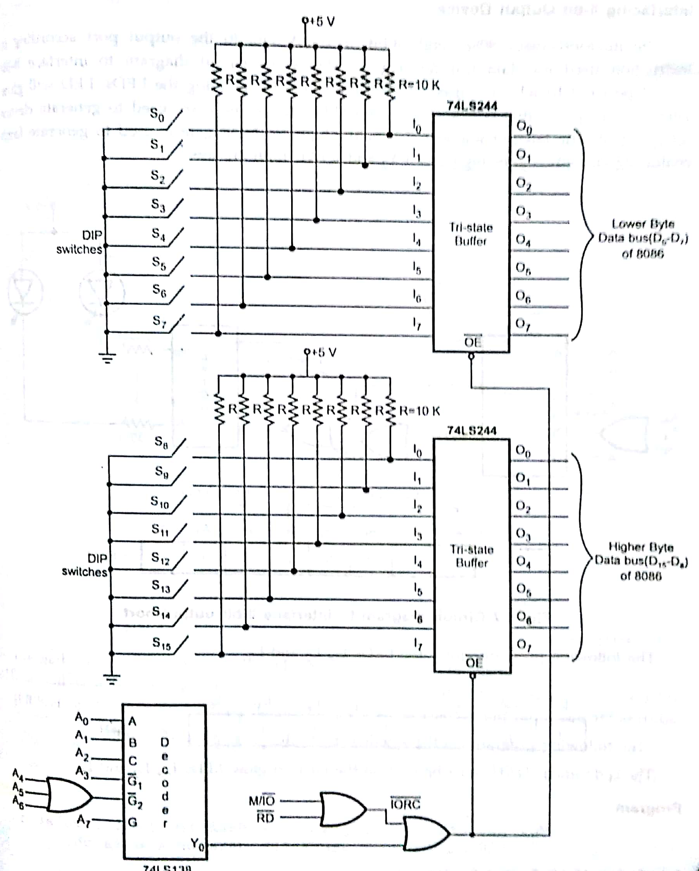
MOV AX,0FFFFH
IN 80H,AX
INT 3
Interfacing 16-bit input port

Slide 22
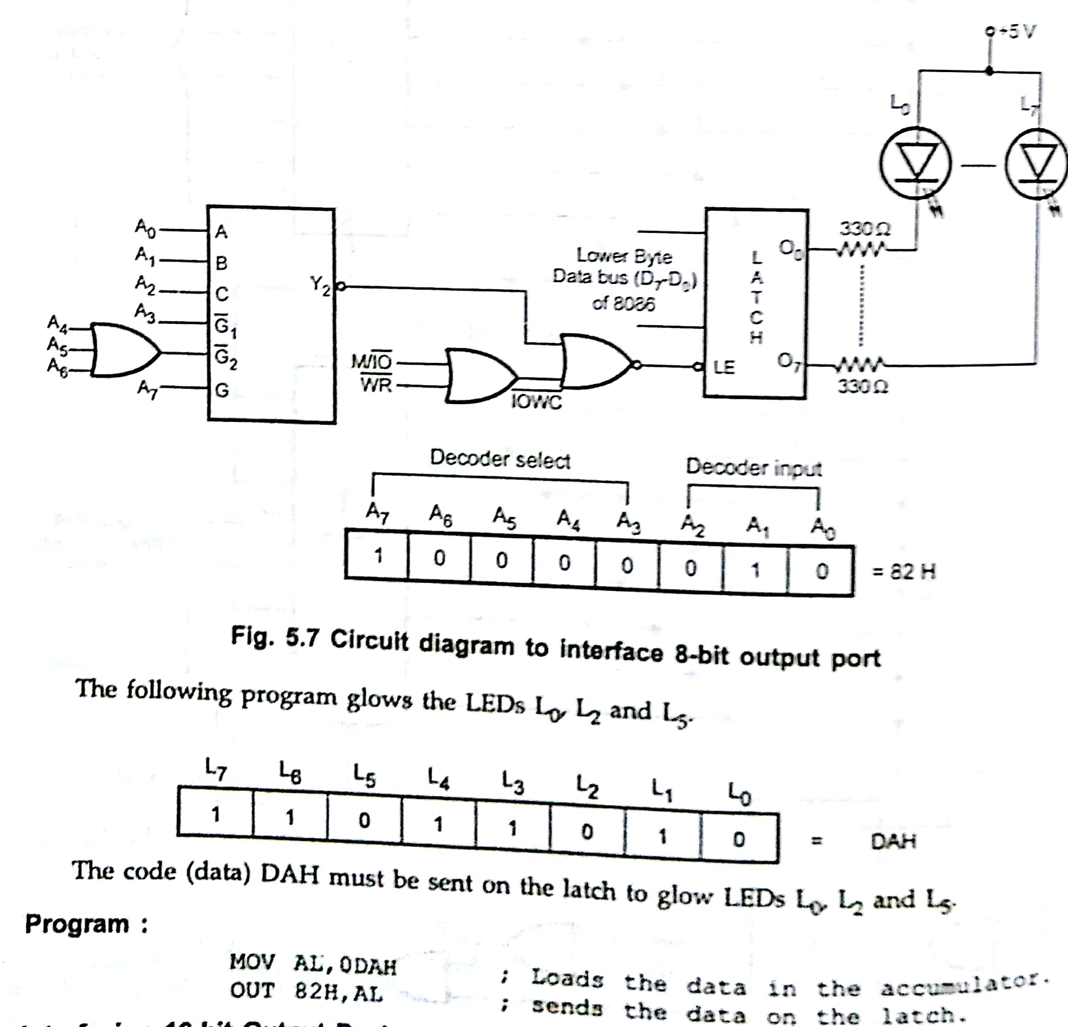
‘I’ LED OFF
‘0’ LED ON
MOV AL,0DAH
OUT 82H,AL
INT 3
Interfacing 8-bit Output port

Slide 23
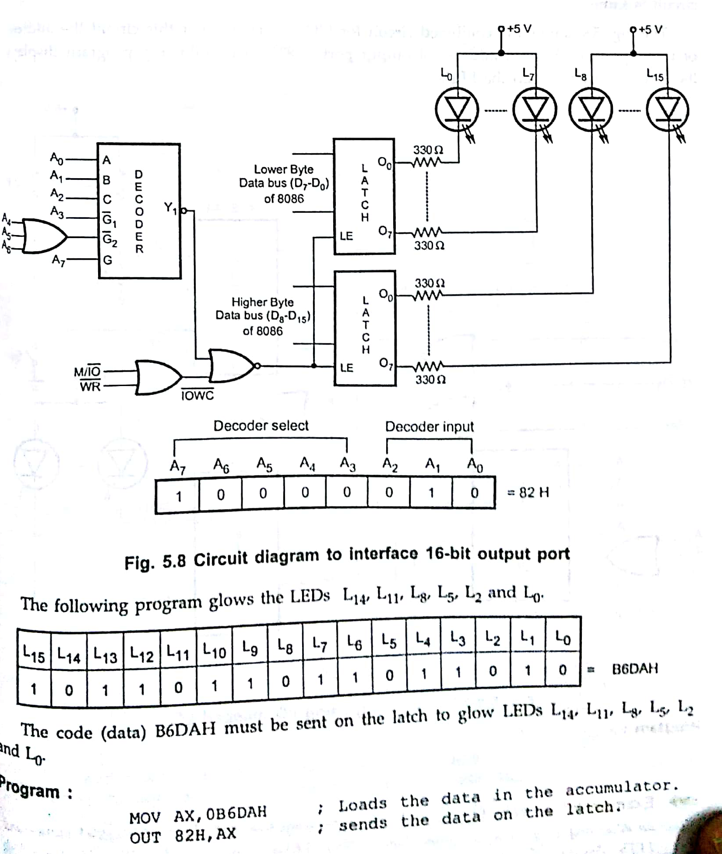
All LEDs are ‘ON’
MOV AX,0000H
OUT 82H,AX
INT 3
Interfacing 16-bit Output port

Slide 24
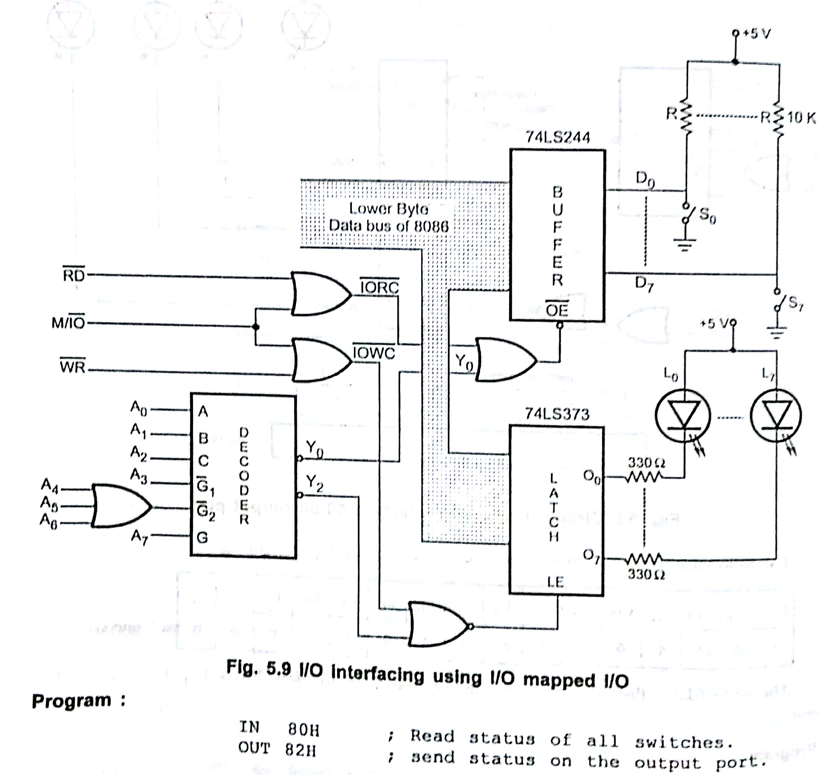
MOV AL,00H
IN 80H,AL
OUT 82H,AL
INT 3
Interfacing 8086 with 8-bit I/O port in I/O mapped I/O

Slide 25
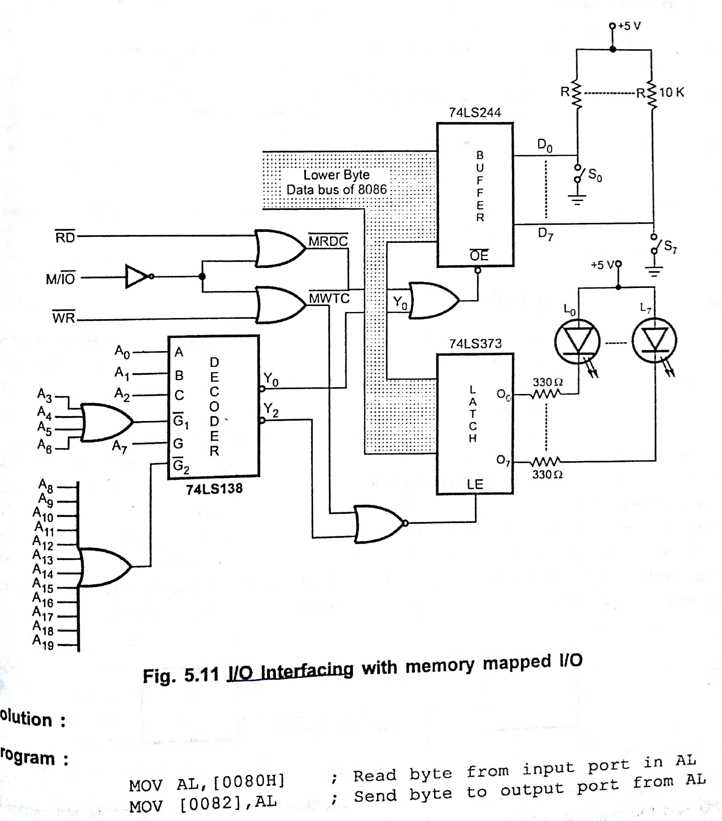
MOV AL,00H
IN 80H,AL
OUT 82H,AL
INT 3
Interfacing 8086 with 8-bit I/O port in memory mapped I/O

Slide 26
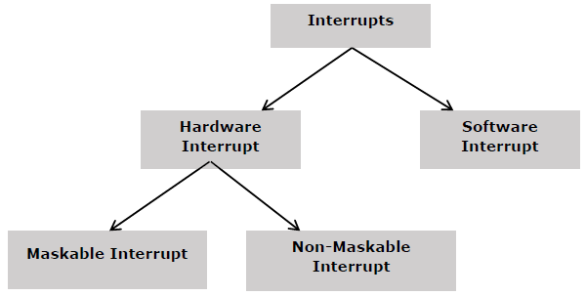
Microprocessor - 8086 Interrupts
Interrupt is the method of creating a temporary halt during program execution and allows peripheral devices to access the microprocessor. The microprocessor responds to that interrupt with an ISR (Interrupt Service Routine), which is a short program to instruct the microprocessor on how to handle the interrupt.
The following image shows the types of interrupts we have in a 8086 microprocessor −

Slide 27
Hardware Interrupts
Hardware interrupt is caused by any peripheral device by sending a signal through a specified pin to the microprocessor.
The 8086 has two hardware interrupt pins, i.e. NMI and INTR. NMI is a non-maskable interrupt and INTR is a maskable interrupt having lower priority. One more interrupt pin associated is INTA called interrupt acknowledge.
NMI
It is a single non-maskable interrupt pin (NMI) having higher priority than the maskable interrupt request pin (INTR)and it is of type 2 interrupt.
When this interrupt is activated, these actions take place −
Completes the current instruction that is in progress.
Pushes the Flag register values on to the stack.
Pushes the CS (code segment) value and IP (instruction pointer) value of the return address on to the stack.
IP is loaded from the contents of the word location 00008H.
CS is loaded from the contents of the next word location 0000AH.
Interrupt flag and trap flag are reset to 0.−

Slide 28
INTR
The INTR is a maskable interrupt because the microprocessor will be interrupted only if interrupts are enabled using set interrupt flag instruction. It should not be enabled using clear interrupt Flag instruction.
The INTR interrupt is activated by an I/O port. If the interrupt is enabled and NMI is disabled, then the microprocessor first completes the current execution and sends ‘0’ on INTA pin twice. The first ‘0’ means INTA informs the external device to get ready and during the second ‘0’ the microprocessor receives the 8 bit, say X, from the programmable interrupt controller.
These actions are taken by the microprocessor −
First completes the current instruction.
Activates INTA output and receives the interrupt type, say X.
Flag register value, CS value of the return address and IP value of the return address are pushed on to the stack.
IP value is loaded from the contents of word location X × 4
CS is loaded from the contents of the next word location.
Interrupt flag and trap flag is reset to 0

Slide 29
Software Interrupts
Some instructions are inserted at the desired position into the program to create interrupts. These interrupt instructions can be used to test the working of various interrupt handlers. It includes −
INT- Interrupt instruction with type number
It is 2-byte instruction. First byte provides the op-code and the second byte provides the interrupt type number. There are 256 interrupt types under this group.
Its execution includes the following steps −
Flag register value is pushed on to the stack.
CS value of the return address and IP value of the return address are pushed on to the stack.
IP is loaded from the contents of the word location ‘type number’ × 4
CS is loaded from the contents of the next word location.
Interrupt Flag and Trap Flag are reset to 0

Slide 30
The starting address for type0 interrupt is 000000H, for type1 interrupt is 00004H similarly for type2 is 00008H and ……so on. The first five pointers are dedicated interrupt pointers. i.e. −
TYPE 0 interrupt represents division by zero situation.
TYPE 1 interrupt represents single-step execution during the debugging of a program.
TYPE 2 interrupt represents non-maskable NMI interrupt.
TYPE 3 interrupt represents break-point interrupt.
TYPE 4 interrupt represents overflow interrupt.
The interrupts from Type 5 to Type 31 are reserved for other advanced microprocessors, and interrupts from 32 to Type 255 are available for hardware and software interrupts.
INT 3-Break Point Interrupt Instruction
It is a 1-byte instruction having op-code is CCH. These instructions are inserted into the program so that when the processor reaches there, then it stops the normal execution of program and follows the break-point procedure.

Slide 31
Its execution includes the following steps −
Flag register value is pushed on to the stack.
CS value of the return address and IP value of the return address are pushed on to the stack.
IP is loaded from the contents of the word location 3×4 = 0000CH
CS is loaded from the contents of the next word location.
Interrupt Flag and Trap Flag are reset to 0
INTO - Interrupt on overflow instruction
It is a 1-byte instruction and their mnemonic INTO. The op-code for this instruction is CEH. As the name suggests it is a conditional interrupt instruction, i.e. it is active only when the overflow flag is set to 1 and branches to the interrupt handler whose interrupt type number is 4. If the overflow flag is reset then, the execution continues to the next instruction.
Its execution includes the following steps −
Flag register values are pushed on to the stack.
CS value of the return address and IP value of the return address are pushed on to the stack.
IP is loaded from the contents of word location 4×4 = 00010H
CS is loaded from the contents of the next word location.
Interrupt flag and Trap flag are reset to 0

Slide 32
8086 Interrupt types
Divide by Zero Interrupt (Type 0)
When the quotient from DIV instruction is too large to fit in the result register, 8086 will automatically execute type 0 interrupt.
2. Single step interrupt (Type 1)
The type 1 interrupt is the single step trap.
3. Non mask able Interrupt (Type 2)
This interrupt cannot be disabled by any software instruction.
4. Breakpoint Interrupt (Type 3)
The type 3 interrupt is used to implement break point function in the system.
5. Overflow interrupt (Type 4)
The type 4 interrupt is used to check overflow condition after any signed arithmetic operation in the system. The 8086 overflow flag (OF) will be represented in the destination register or memory location.
Type 0- 255:
Each interrupt type requires 4 locations because of two 16 bit registers
4*256=2²*2⁸=2¹⁰
0000000000-000h
1111111111-3FFH

Slide 33
Interrupt Service Routine
Interrupts in 8086 microprocessor
An interrupt is a condition that halts the microprocessor temporarily to work on a different task and then return to its previous task. Interrupt is an event or signal that request to attention of CPU. This halt allows peripheral devices to access the microprocessor.
Whenever an interrupt occurs the processor completes the execution of the current instruction and starts the execution of an Interrupt Service Routine (ISR) or Interrupt Handler. ISR is a program that tells the processor what to do when the interrupt occurs. After the execution of ISR, control returns back to the main routine where it was interrupted.

Slide 34
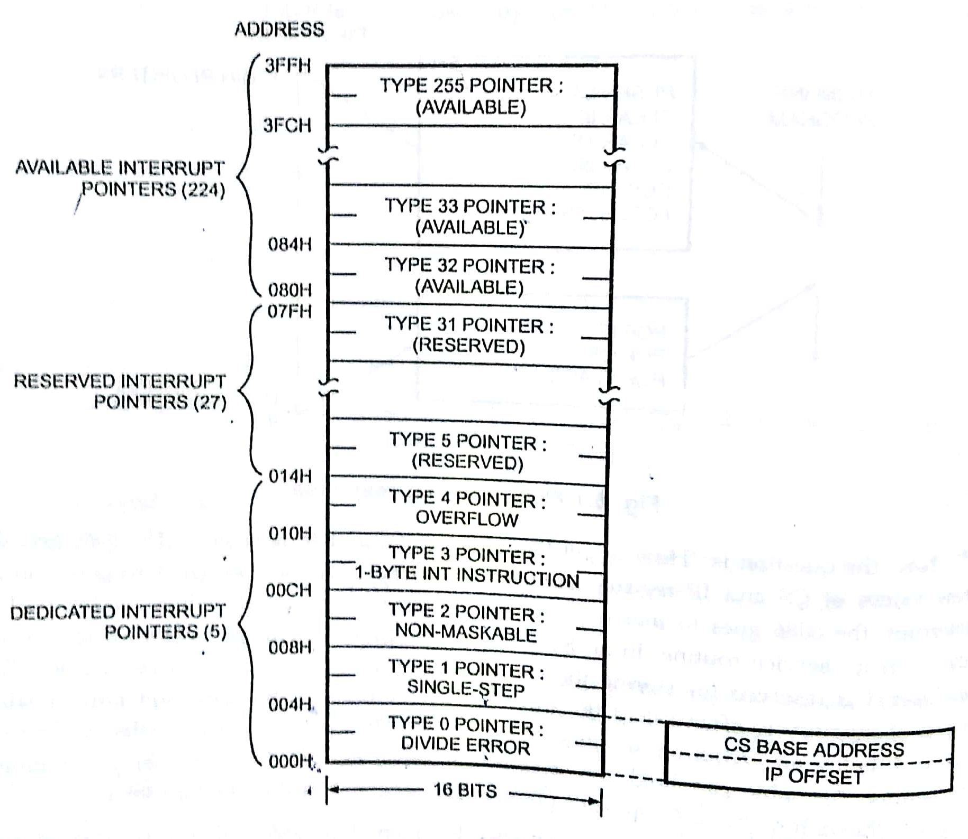
Interrupt vector table

